Slide 1
Cryptography and System Security (CSS)
T.E – Sem.-VI
-Ms. Nabanita Mandal

Slide 2
Substitution Ciphers
It can be categorized as:
  Monoalphabetic Cipher
    Additive Cipher
    Shift Cipher
    Caesar Cipher
    Multiplicative Cipher
    Affine Cipher
  Polyalphabetic Cipher
    Autokey Cipher
    Playfair Cipher
    Hill Cipher
    Vigenere cipher
Notes:
In this section and the next, we examine a sampling of what might be called classical encryption
techniques. A study of these techniques enables us to illustrate the basic approaches to
symmetric encryption used today and the types of cryptanalytic attacks that must be anticipated.
The two basic building blocks of all encryption techniques: substitution and transposition.
We examine these in the next two sections. Finally, we discuss a system that combine both
substitution and transposition.

Slide 3
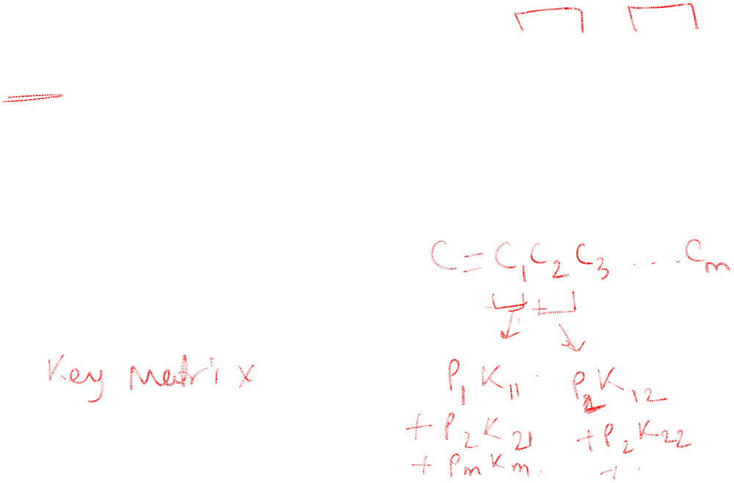
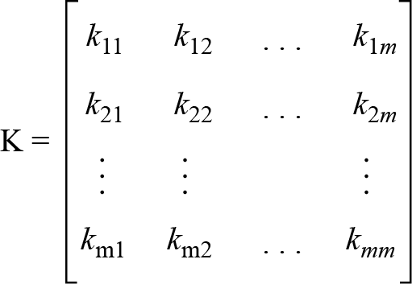
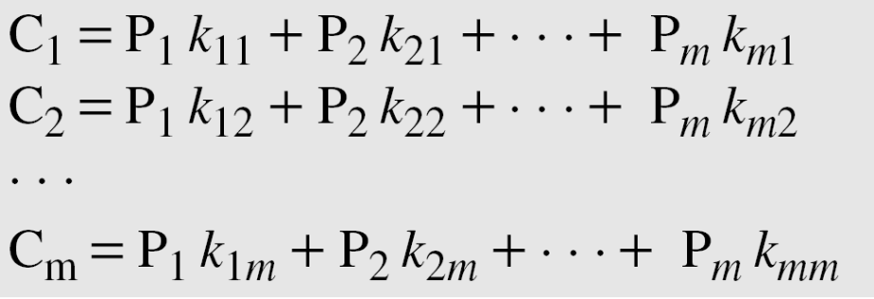
Hill Ciphers
The key matrix in the Hill cipher needs to have a multiplicative inverse.
Notes:
In this section and the next, we examine a sampling of what might be called classical encryption
techniques. A study of these techniques enables us to illustrate the basic approaches to
symmetric encryption used today and the types of cryptanalytic attacks that must be anticipated.
The two basic building blocks of all encryption techniques: substitution and transposition.
We examine these in the next two sections. Finally, we discuss a system that combine both
substitution and transposition.

Slide 4
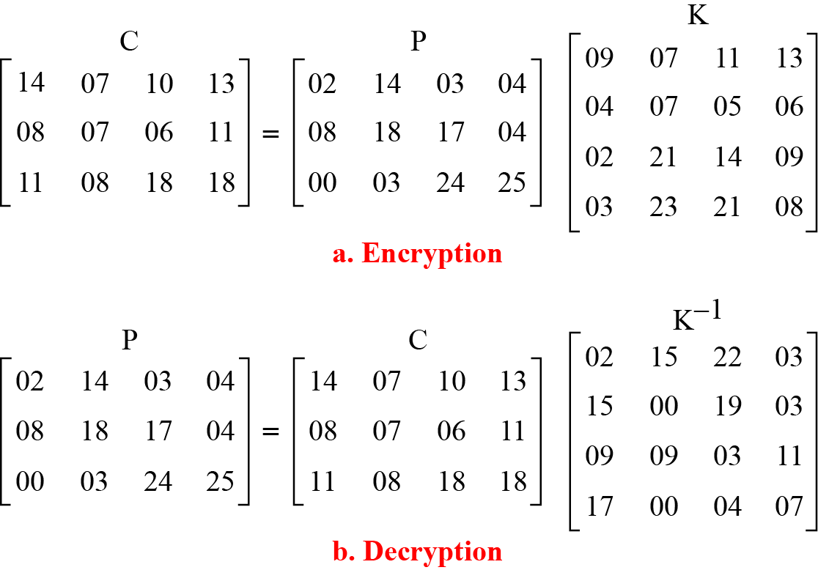
Hill Ciphers
For example, the plaintext “code is ready” can make a 3 × 4 matrix when adding extra bogus character “z” to the last block and removing the spaces. The ciphertext is “OHKNIHGKLISS”.
Notes:
In this section and the next, we examine a sampling of what might be called classical encryption
techniques. A study of these techniques enables us to illustrate the basic approaches to
symmetric encryption used today and the types of cryptanalytic attacks that must be anticipated.
The two basic building blocks of all encryption techniques: substitution and transposition.
We examine these in the next two sections. Finally, we discuss a system that combine both
substitution and transposition.

Slide 5
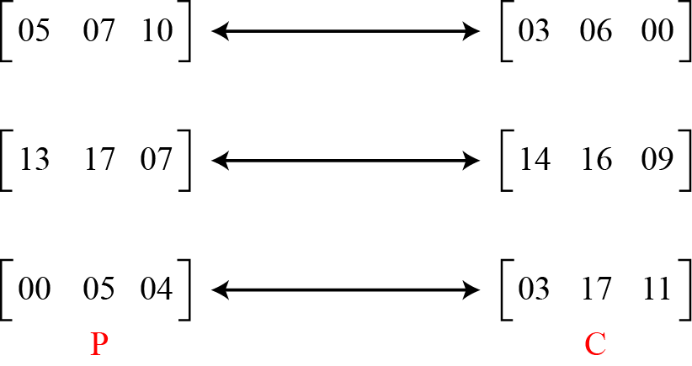
Hill Ciphers
Assume that Eve knows that m = 3. She has intercepted three plaintext/ciphertext pair blocks (not necessarily from the same message)
Notes:
In this section and the next, we examine a sampling of what might be called classical encryption
techniques. A study of these techniques enables us to illustrate the basic approaches to
symmetric encryption used today and the types of cryptanalytic attacks that must be anticipated.
The two basic building blocks of all encryption techniques: substitution and transposition.
We examine these in the next two sections. Finally, we discuss a system that combine both
substitution and transposition.

Slide 6
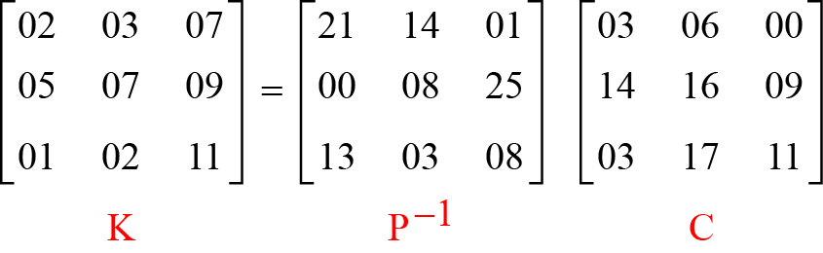
Hill Ciphers
She makes matrices P and C from these pairs. Because P is invertible, she inverts the P matrix and multiplies it by C to get the K matrix
Now she has the key and can break any ciphertext encrypted with that key.
Notes:
In this section and the next, we examine a sampling of what might be called classical encryption
techniques. A study of these techniques enables us to illustrate the basic approaches to
symmetric encryption used today and the types of cryptanalytic attacks that must be anticipated.
The two basic building blocks of all encryption techniques: substitution and transposition.
We examine these in the next two sections. Finally, we discuss a system that combine both
substitution and transposition.

Slide 7
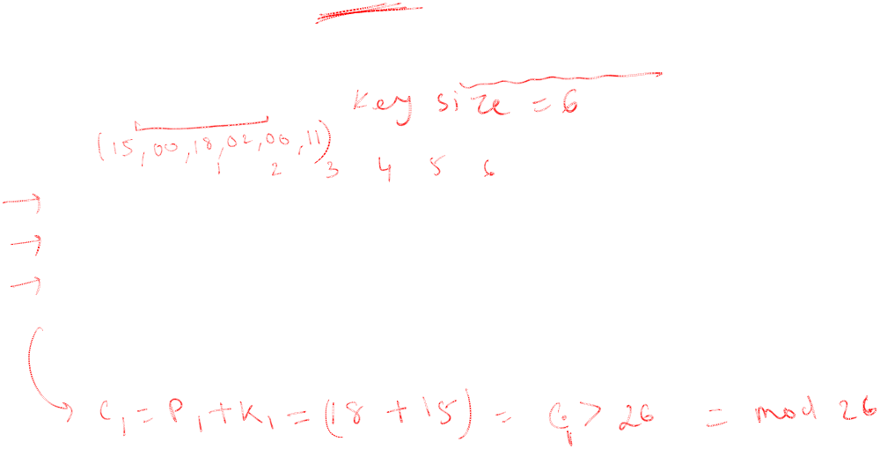
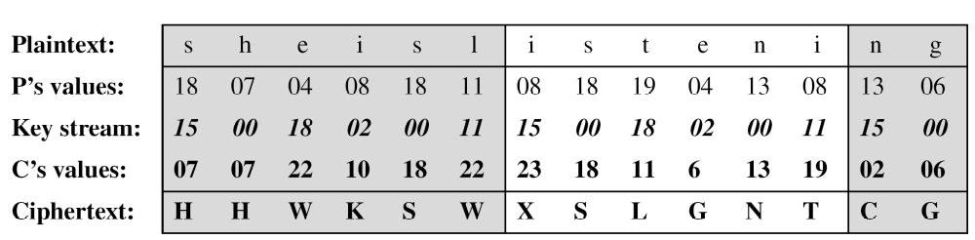
Vigenere Ciphers
We can encrypt the message “She is listening” using the 6-character keyword “PASCAL”.
Notes:
In this section and the next, we examine a sampling of what might be called classical encryption
techniques. A study of these techniques enables us to illustrate the basic approaches to
symmetric encryption used today and the types of cryptanalytic attacks that must be anticipated.
The two basic building blocks of all encryption techniques: substitution and transposition.
We examine these in the next two sections. Finally, we discuss a system that combine both
substitution and transposition.

Slide 8
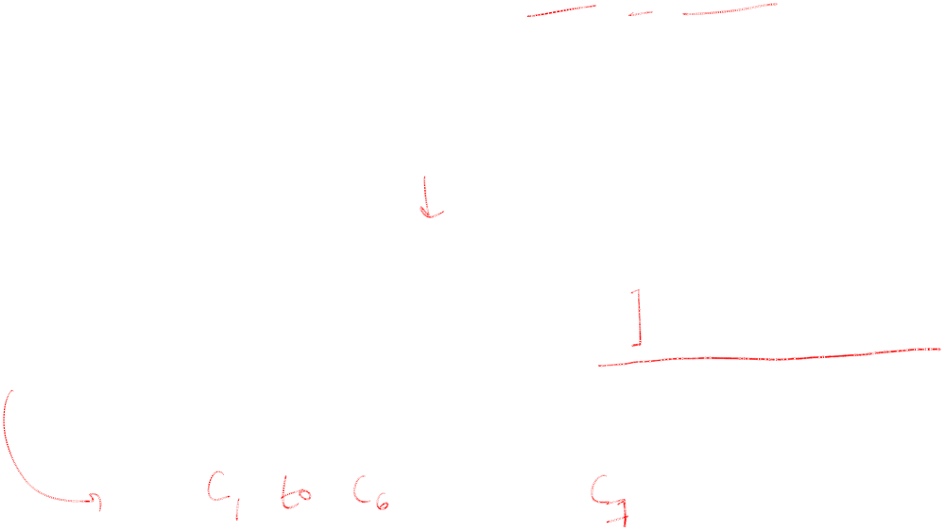
Vigenere Ciphers
We can encrypt the message “She is listening” using the 6-character keyword “PASCAL”. The initial key stream is (15, 0, 18, 2, 0, 11). The key stream is the repetition of this initial key stream (as many times as needed).
Notes:
In this section and the next, we examine a sampling of what might be called classical encryption
techniques. A study of these techniques enables us to illustrate the basic approaches to
symmetric encryption used today and the types of cryptanalytic attacks that must be anticipated.
The two basic building blocks of all encryption techniques: substitution and transposition.
We examine these in the next two sections. Finally, we discuss a system that combine both
substitution and transposition.

Slide 9
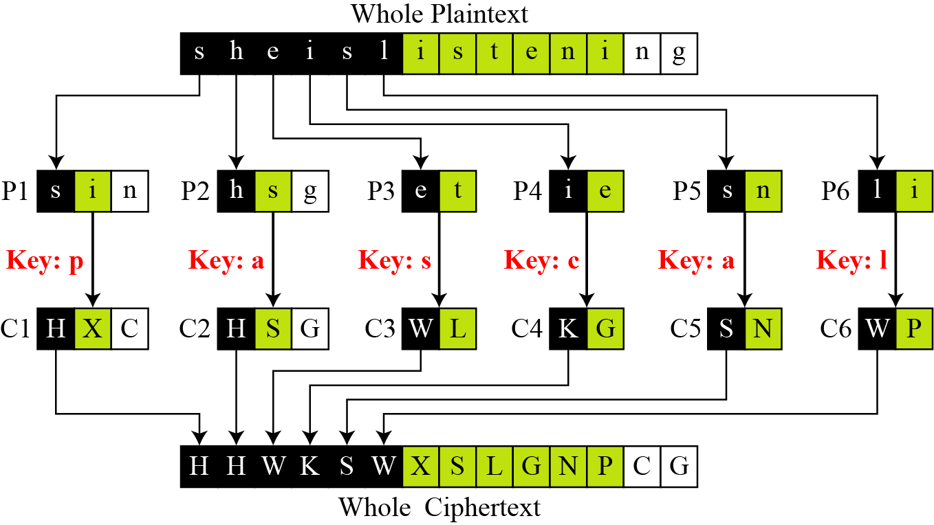
Vigenere Ciphers
Vigenere cipher can be seen as combinations of m additive ciphers
Notes:
In this section and the next, we examine a sampling of what might be called classical encryption
techniques. A study of these techniques enables us to illustrate the basic approaches to
symmetric encryption used today and the types of cryptanalytic attacks that must be anticipated.
The two basic building blocks of all encryption techniques: substitution and transposition.
We examine these in the next two sections. Finally, we discuss a system that combine both
substitution and transposition.

Slide 10
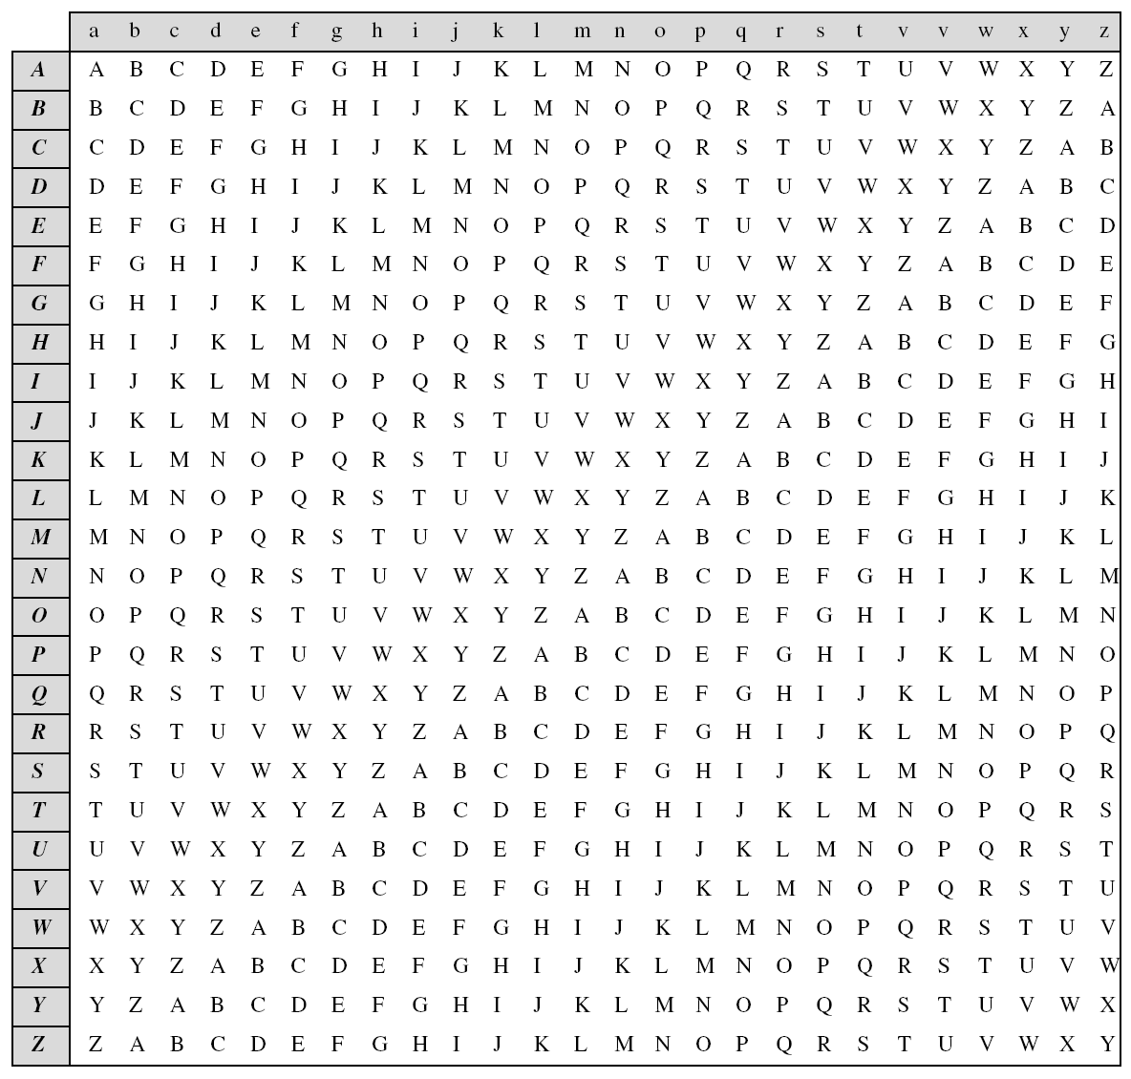
Vigenere
Ciphers
A Vigenere
Tableau
Notes:
In this section and the next, we examine a sampling of what might be called classical encryption
techniques. A study of these techniques enables us to illustrate the basic approaches to
symmetric encryption used today and the types of cryptanalytic attacks that must be anticipated.
The two basic building blocks of all encryption techniques: substitution and transposition.
We examine these in the next two sections. Finally, we discuss a system that combine both
substitution and transposition.

Slide 11
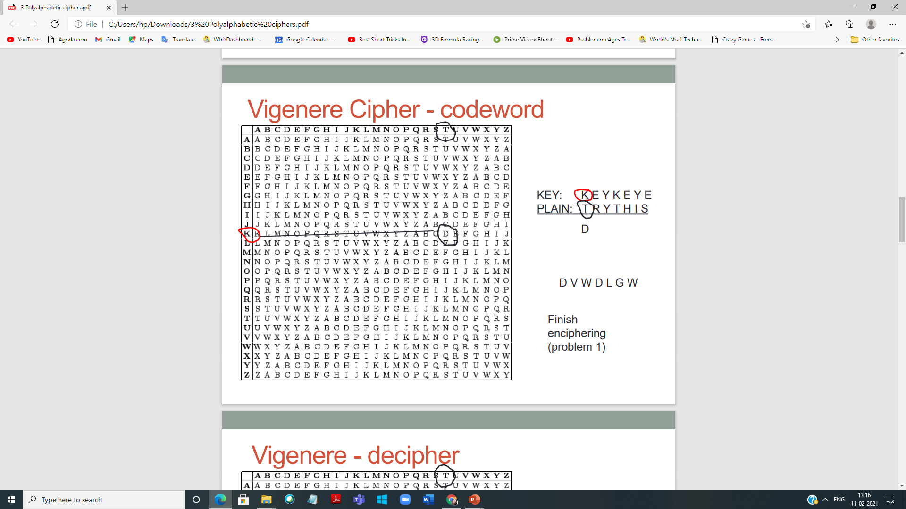

Vigenere Ciphers
Notes:
In this section and the next, we examine a sampling of what might be called classical encryption
techniques. A study of these techniques enables us to illustrate the basic approaches to
symmetric encryption used today and the types of cryptanalytic attacks that must be anticipated.
The two basic building blocks of all encryption techniques: substitution and transposition.
We examine these in the next two sections. Finally, we discuss a system that combine both
substitution and transposition.

Slide 12
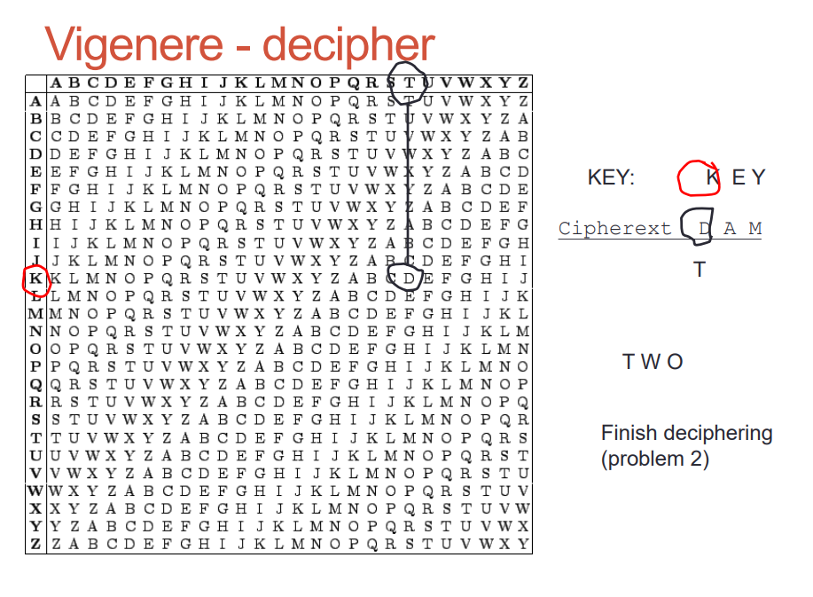
Vigenere Ciphers
Notes:
In this section and the next, we examine a sampling of what might be called classical encryption
techniques. A study of these techniques enables us to illustrate the basic approaches to
symmetric encryption used today and the types of cryptanalytic attacks that must be anticipated.
The two basic building blocks of all encryption techniques: substitution and transposition.
We examine these in the next two sections. Finally, we discuss a system that combine both
substitution and transposition.

